Slide 1
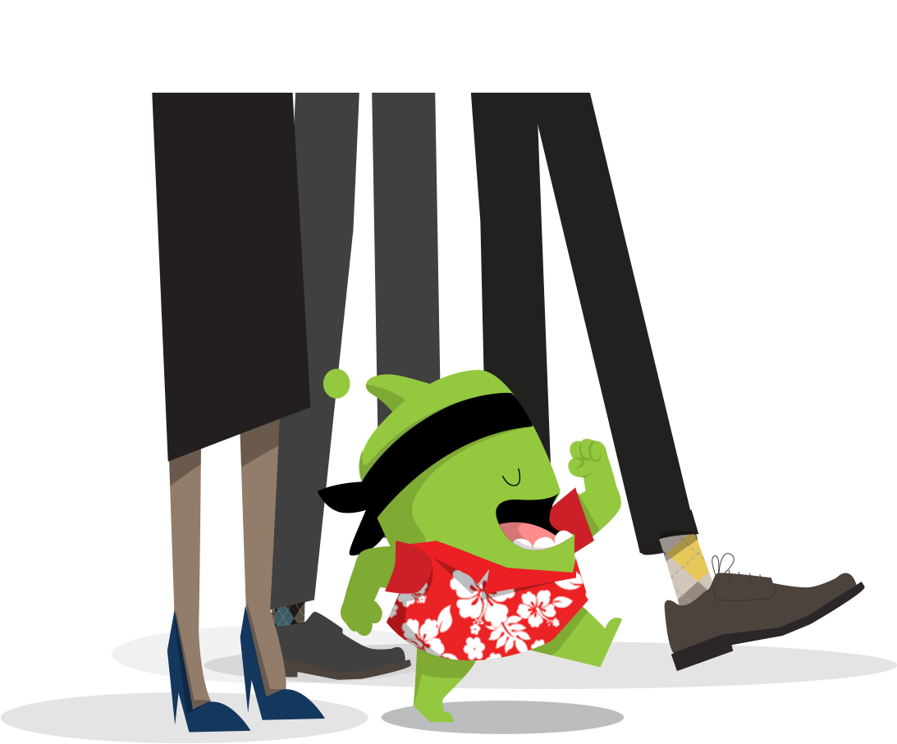

Y6 Class Expectations
2022/23
Mr Druce, Mrs Goodes, Mrs Martin and Mrs Edwards
Welcome!

Slide 2
Welcome
This September we have continued the ‘Class Expectation Evenings’ online but as in previous years the aim is to inform you of all the information that you need to help the year run as smoothly as possible and to give you a better idea of what is expected from the children in Year 6.
The year 6 team have all been extremely impressed at how well the children have settled into coming back after the summer and we are excited about our year of learning ahead!

Slide 3
In this presentation we will cover:
Curriculum
Assessment
Learning at home
Learning behaviour
School mission statement and values
Questions

Slide 4
Curriculum overview
Termly topics:
Autumn – World War 1 and 2 (history focus) and Our Changing Highstreet (local history focus)
Spring- Passport to Brazil (Geography focus on Brazil and South America).
Summer – Mayan Civilisation (History focus)
These topics are further broken down into mini topics that focus on different subject areas.

Slide 5
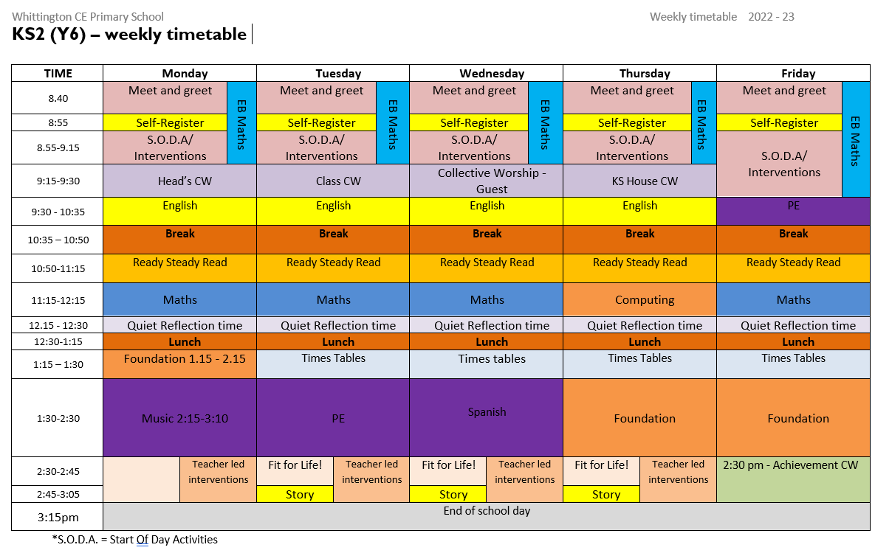
Timetable – Each week we usually follow this timetable although at times we do block subjects e.g. do a whole day of science or have an art day.

Slide 6
Assessment
Teacher assessment is ongoing in every lesson through observing the children working. From these observations we identify children who may be finding a piece of work tricky. We then aim to work with that child separately or in small group during intervention time later in the day.
More formal assessment tests take place in the Autumn and Spring terms ready for the SATs in May for year 6.

Slide 7
Home-School Learning
What is Home-School Learning? Home-School Learning is anything that children do outside of the normal school day that contributes to their learning in school. This encompasses a whole variety of activities instigated by teachers and parents/carers to support a child's learning.
Daily Home – School Learning:
Reading to and with children – school reading books, library books, magazines. We love to see children reading every day. Try to talk to children about their reading and their understanding of the texts. However, this should not impact upon reading for enjoyment.
We want children to be reading for pleasure at home.
Reading is vital in all areas of education (including maths).
Children need to make sure they have a reading book with them everyday at school.

Slide 8
Home-School Learning
Rehearsal of arithmetic (number bonds and times tables): Little and often – a couple of minutes a few times a day makes all the difference. There are plenty of ways to practice these facts now such as Times Tables Rockstars and Purple Mash as well as more traditional chanting etc.
Spellings: For our spellings this year we will mainly be focussing on the year 6 spelling rules and patterns. The year 5 and 6 statutory spellings and the high and medium frequency words lists are also worth practicing.
Weekly task: Every FRIDAY we will be setting a weekly task for home learning that the children need to complete by the following WEDNESDAY.
SATS past papers: After October half term, SATs past papers will be given out to year 6 children as part of their weekly homework. These will alternate between the reading, grammar and maths papers.
Thematic parent/child projects based upon in-class learning – this may include research, shared activities, craft or other projects that teachers think will support and extend learning and encourage conversations at home.

Slide 9
Relationships Education and Health Education
As of September 2020 a new Relationships Education curriculum has been introduced by the Government which we will be developing this year. This will include learning about families, caring friendships, respectful relationships, online relationships and staying safe. These topics will be covered in a number of subjects including computing and science. More details will be sent home through the year as we develop our approach to this area of the curriculum.

Slide 10
PE
PE Kit should be in school EVERY DAY and can then go home for a wash at the end of the week.
If a PE kit is forgotten on a number of occasions then this will result in a conversation with parents.
We will not be texting parents to bring in PE kits if a child forgets it.
Reminder of kit requirements:
-Dark plain shorts
-Red T-shirts (School logo preferable)
-Trainers
-Dark jogging bottoms if cold
-No t-shirts with logos or football shirts etc

Slide 11
Classroom equipment
Pencil cases – children need to have all their own equipment in their pencil cases and must not share any stationary. This includes: pens, a pencil, a rubber, a ruler, colured pencils, couloured pens, a protractor, highlighters and a cannister pencil sharpener.
Water bottles - Water fountains are out of action for the foreseeable future so the children will need a water bottle with them please. The children are allowed bottles in the classroom but these ones just need to have water in please.

Slide 12

This year, we’re using ClassDojo to build our classroom community
We’ll build a positive culture where students are engaged, encouraged, and love learning!
All parents are part of our classroom community, seeing what we’re learning every day.

Slide 13

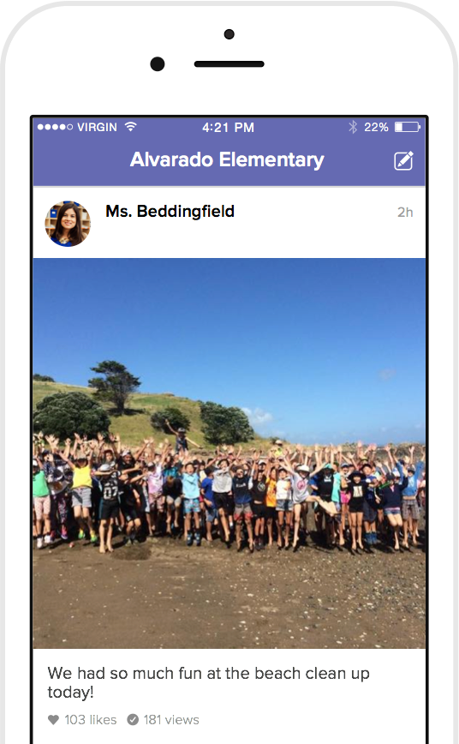
How we’ll use ClassDojo
As a teacher, I will:
Post announcements and updates regularly on Class Story
Share photos and videos of our classroom activities
Send private messages to keep you in the loop!

Slide 14
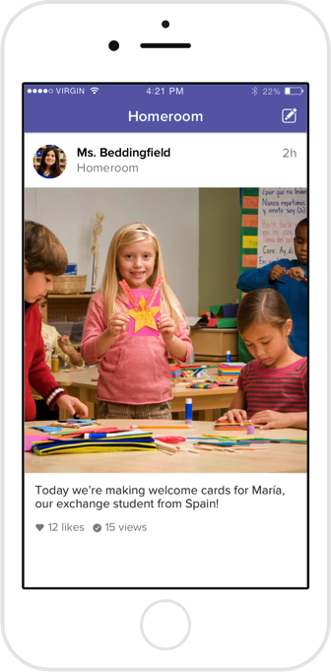
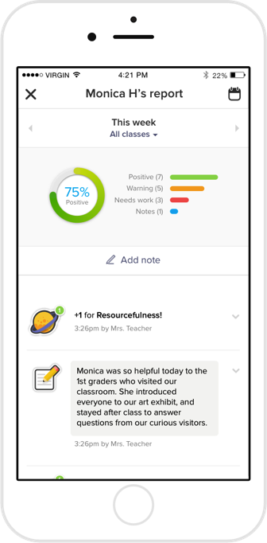
What do parents see?
You’ll see the Story of our classroom:
Photos and videos from class
Important updates and announcements
Your child’s dojo points
Private messaging between the two of us

Slide 15
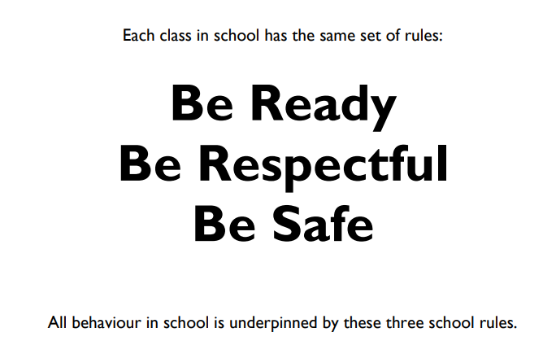
Classroom learning behaviour

Slide 16
Classroom learning behaviour
In class and around school we have lots of ways to recognise and celebrate positive behaviour. This includes:
Dojos
Recognition board
Pozzy notes
Weekly achievement certificate
Hot Chocolate with Mr Rogers
Scratch cards
Where we see more persistent negative behaviours we give warnings followed by impositions (time to reflect during break times) and speaking to parents where necessary.

Slide 17
Our mission statement

Slide 18
Our mission statement

Slide 19
Any concerns
Any questions?
If you have any further questions or anything specific regarding your child please send a message via Dojo.
Any issues or concerns over the course of the year please do let us know either through dojo or in person at the end of the day.

