Slide 1
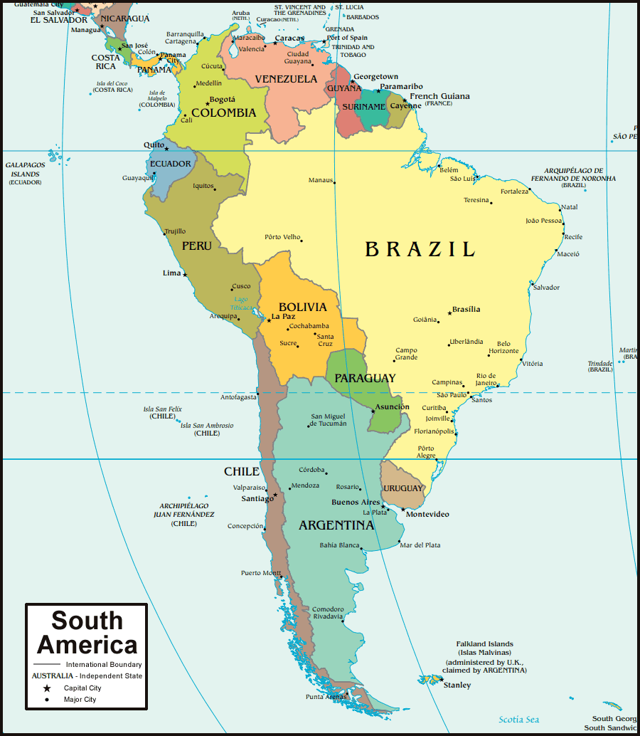

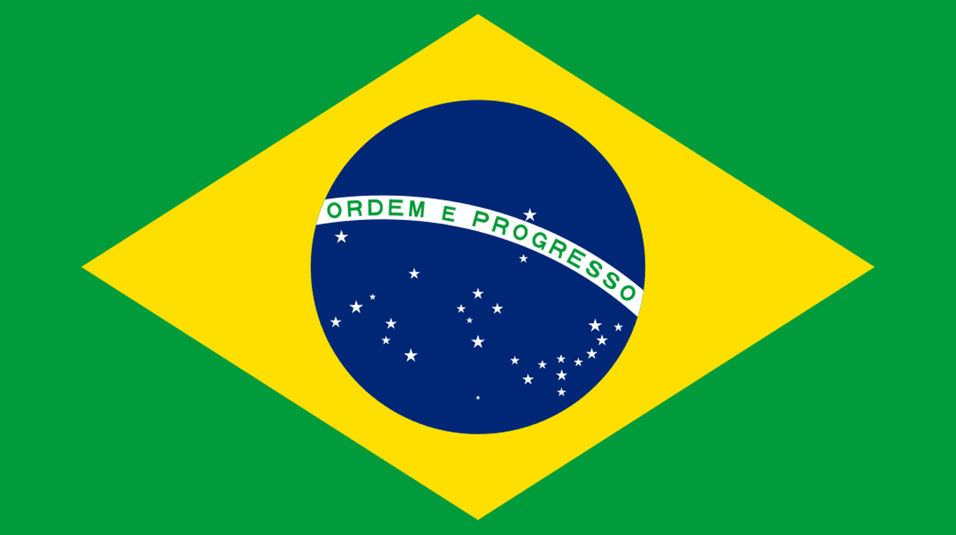
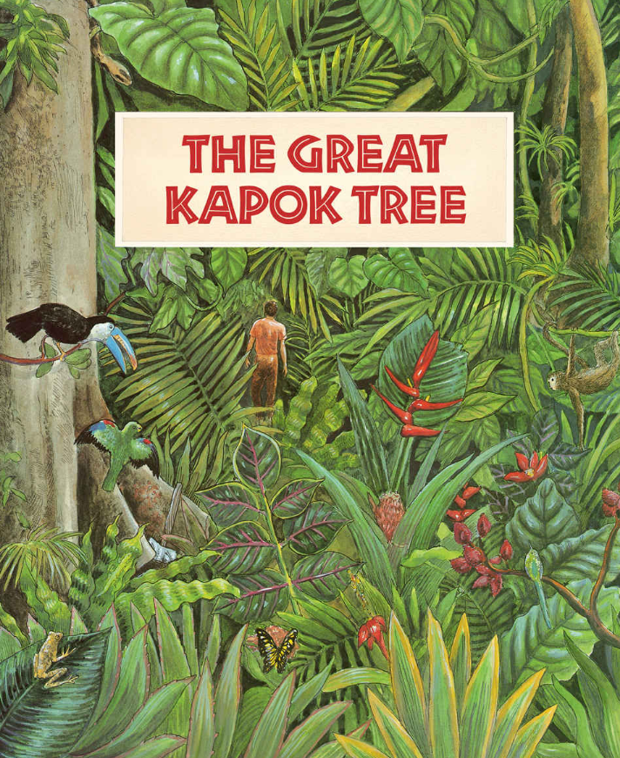
Year 6 – Passport to Brazil
Subject Specific Vocabulary
Deforestation | The removal of trees for different purposes.
Climate | Weather conditions in an area of a long period of time.
Population | Number of people that live in a certain area.
Land area | The area of ground used for a particular purpose, usually measure in square kilometres.
Tropical rainforest | A hot, humid, and flourishing dense forest, usually found around the equator.
Emergent layer | The top layer of the tropical rainforest.
Canopy layer | Located below the emergent layer of the tropical rainforest.
Understory layer | The next layer down after the canopy layer.
Forest floor layer | The bottom layer of the tropical rainforest, the forest floor.
Biomes | Biomes are areas of the planet with a similar climate and landscape, where similar animals and plants live.
Human features | Areas of land which are man-made. They are there because of human ideas and actions.
Physical features | These are the physical characteristics of the land and are there naturally (mountains, rivers etc.)
Capital city | The city or town that functions as the seat of government
Exciting Reads
Key Learning
Brazil is the largest country in South America, encompassing around half of the continent's land area and population. The capital city is Brasilia and other large cities include Sao Paulo, Rio De Janeiro Salvador and Fortaleza. It borders 10 other countries: Uruguay, Argentina, Paraguay, Peru, Bolivia, Colombia, Venezuela, Guyana, Suriname and French Guiana. (Every country in South America except: Chile and Ecuador!) Around 60% of the Amazon rainforest is located in Brazil. The Amazon rainforest is the largest tropical rainforest in the world and covers over 5.5 million square kilometres. Brazil is also home to the second longest river in the world, the Amazon River. Brazil hosts the worlds largest carnival, in Rio De Janeiro, which sees approximately 2 million people take to the streets to enjoy music, dancing and parades in incredible carnival outfits.

