Slide 1

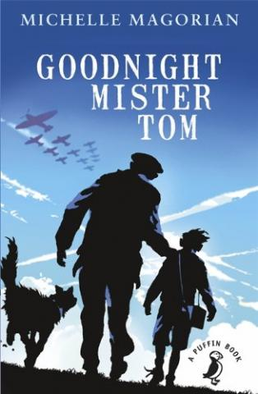
Key Learning
WWI started in 1914 due to the assassination of Archduke Franz Ferdinand, and ended on the 11th November 1918. The allied forces were France, UK, Italy, Russia and USA and the opposition, called the central powers, were Germany, Austria, The Ottoman Empire (Turkey) and Bulgaria. WW2 started in 1939 when Germany decided to invade Poland. The fighting ended in Europe in May 1945 after Germany surrendered and in September when Japan surrendered. The main countries involved were France, UK, Soviet Union and USA, known as the allied powers. The main opposition countries were Germany, Italy, Bulgaria and Japan, known as the axis powers. During the Blitz, there were many air raids where Germany frequently bombed London and other large cities, meaning many children had to be evacuated to the countryside.
Exciting Reads
Year 6 – World War I and II
Subject Specific Vocabulary
Air raid | An attack by enemy planes dropping bombs.
Alliance | When countries join forces or work together to achieve a certain goal.
Blitz | A prolonged period of German air raids on Britain. From the German ‘blitzkrieg’ which means ‘lightning war’.
Concentration camps | Prisons where Jewish people and other prisoners were held by the Nazis in WW2.
Conscription | The requirement by law to join the armed forces.
Evacuation | Moving people from dangerous areas to safer places e.g. from big cities to the countryside to avoid bombing.
Front Line | The area where the armies are engaged in fighting.
Genocide | Deliberate action to destroy a people (usually defined as an ethnic, national, racial, or religious group).
Holocaust | The mass murder of around six million Jewish people by the Nazis, as well as other persecuted groups during WW2.
Nazi | Short for National Socialist Party (in Germany) and the name given to supporters of Hitler.
Treaty | A written agreement between two or more countries.
Trench | Long ditches dug into the ground where soldiers lived.
Local Heritage
WWI – Oswestry Hillfort was used as a training facility to simulate trench warfare. Wilfred Owen would have been in attendance at this training facility. Park Hall was a WWII army base where soldiers and their families lived. Children who were evacuated from large cities would have ended up in Whittington.
Timeline – World War I
28th June 1914 | 28th July 1914 | August 1914 | September 1914 onwards | April 1917 | December 1917 | 11th November 1918
Archduke Franz Ferdinand of Austria is assassinated by a Serbian terrorist. | Following a number of threats, Austria-Hungary declares war on Serbia. | Germany declares war on Russia in support of Austria-Hungary before declaring war on France. Following a German invasion of Belgium, Britain declares war on Germany. | The German army is stopped short of Paris by British and French soldiers. Both sides dig in and trench warfare begins with only tiny gains achieved. | The United States of America declares war on Germany, providing France and Britain with much needed financial and military support. | Following a revolution in Russia that sees new leaders, Russia signs an armistice that sees them withdraw from the war. | An armistice is agreed that sees Germany admit defeat at the end of the war. Guns officially fall silent at 11am
Timeline – World War II
1st – 3rd September 1939 | 26th May – 4th June 1940 | 10th July – 31st October 1940 | 7th December 1941 | 6th June 1944 | 30th April 1945 | 7th May 1945 | 6th – 9th August 1945 | 2nd September 1945
On 1st September 1939, Germany invaded Poland. Britain and France (Poland’s allies) gave Germany notice to withdraw their troops. When they did not, Neville Chamberlain declared war on 3rd September 1939. | Then evacuation of Dunkirk - Large numbers of British, French and Belgian troops were surrounded by German soldiers on the northern coast of France. 800 British boats set out and rescued many of them against the odds, although many men died. | The Battle of Britain - the Royal Air Force (RAF) successfully defended Britain from attacks by Nazi Germany’s Luftwaffe planes. | The attack on Pearl Harbour - This was a surprise military attack by the Japanese on the naval base at Pearl Harbour in Hawaii. It led to the US joining the Allies in the war. | D-Day landings - Also known as the Normandy Landings, these were a series of landing operations by the Allies to claim back Europe. | Hitler’s Suicide - With the German army facing defeat, Hitler married his partner Eva Braun on the 29th April and the next day they committed suicide. | Germany officially surrendered to the Allies, bringing an end to the fighting in Europe. | Japan refused to surrender. The US considered invading, but instead dropped atomic bombs on Hiroshima (6th August) and Nagasaki (9th August). | Japan surrendered on August 15th and this was formally signed on the 2nd September 1945.

