Slide 1
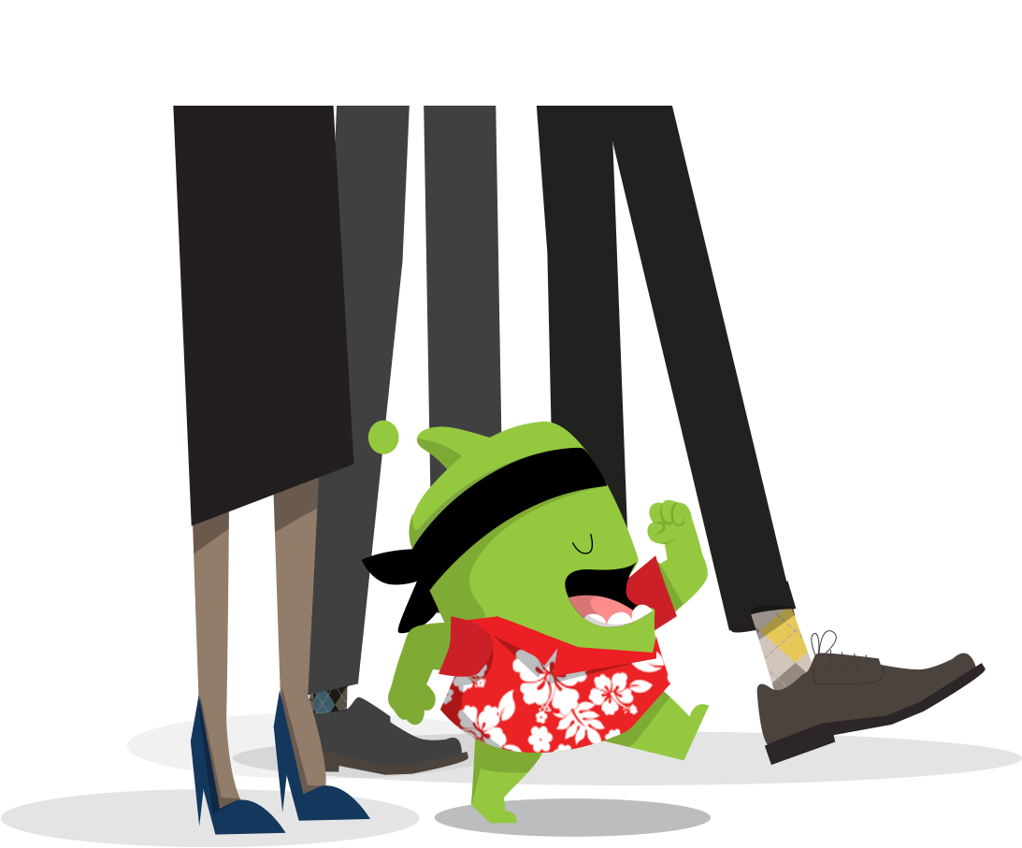

Y3 Class Expectations
2022
Welcome!

Slide 2
In this presentation we will cover:
Our class
Curriculum
Assessment
Learning at home
Learning behaviour
School mission statement and values
Questions

Slide 3
Our class
Teachers: Mrs Simkin, Mrs Watkins and Mrs Frost (for the Autumn Term)
Teaching Assistants: Mrs Chesters, Miss Clark and Mrs Ryan.
(The Teaching Assistants work across years 3 and 4)

Slide 4
Curriculum overview
Termly topics
Autumn – STONE AGE TO IRON AGE and CASTLES (focusing on local history) (History focus).
Spring- PASSPORT TO GREAT BRITAIN ( Geography focus).
Summer – AWESOME EGYPT
(History – Focus on a non-European society).
These topics are further broken down into mini topics that focus on different subject areas. Within mini topics we teach with a cross curricular approach e.g. a mixture of history, art and English for this current topic.

Slide 5
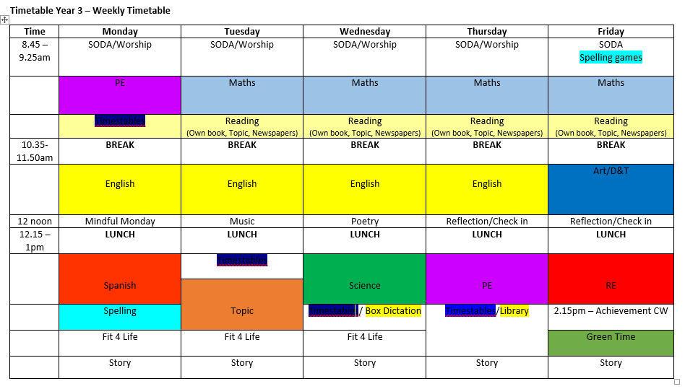
Timetable – Each week we usually follow this timetable although it is subject to change depending on what is going on in school.

Slide 6
Assessment
Teacher assessment is ongoing in every lesson through observing the children working. From these observations we identify children who may be finding a piece of work tricky. We then aim to work with that child separately or in small group during intervention time later in the day.
More formal assessment tests take place in the Autumn and Summer terms, in the form of tests, with the aim of finding out what the children have mastered and the things that they still need to work on.
Writing will be assessed formally twice per term but as far as the children will know this is just like any other piece of writing.

Slide 7
Home-School Learning
What is Home-School Learning? Home-School Learning is anything that children do outside of the normal school day that contributes to their learning in school. This encompasses a whole variety of activities instigated by teachers and parents/carers to support a child's learning.
Daily Home – School Learning:
Reading to and with children – school reading books, library books, magazines. We love to see children reading every day. Try to talk to children about their reading and their understanding of the texts. However, this should not impact upon reading for enjoyment.
The expectation is that children read as often as possible, ideally every day, and that they record what they have read in their Home School Diaries. When children complete a book and their diary is signed to say so, they can change it.
Children need to make sure they have a reading book with them everyday at school.
We will share which times tables and spelling patterns the children are learning in class. Although there will be no formal testing of these, it is always helpful for children to practice these at home.

Slide 8
Home-School Learning
Thematic parent/child projects based upon in-class learning – this may include research, shared activities, craft or other projects that teachers think will support and extend learning and encourage conversations at home.
Project
Each term we the children will be asked to complete a project based on our topic. This is to encourage the children to explore the topic further, especially in an area they are most interested in. It may take a variety of forms and is meant to be lots of fun and something to share with the family. Where possible, we will then share these with their peers.

Slide 9
Relationships Education and Health Education
As of September 2020 a new Relationships Education curriculum has been introduced by the Government which we will be developing this year. This will include learning about families, caring friendships, respectful relationships, online relationships and staying safe. These topics will be covered in a number of subjects including computing and science. More details will be sent home through the year as we develop our approach to this area of the curriculum.

Slide 10
P.E.
P.E. kit should be in school every day and can then go home to be washed at the end of the week.
If a P.E. kit is forgotten repeatedly then reminder messages will be sent on Dojo.
We will not be texting parents to bring in P.E. kits if a child forgets it.
Reminder of kit requirements:
-Dark plain shorts
-Plain red T shirts (School logo preferable)
-Trainers
-Dark jogging bottoms if cold
-No t-shirts with logos or football shirts etc please.

Slide 11
Drinks
Water bottles should be taken home each day, cleaned out and refilled ready for the next day. It is important that children have regular access to water in their own bottles throughout the day.

Slide 12

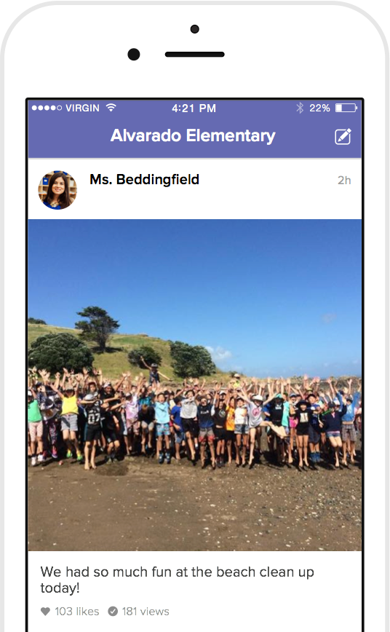
How we’ll use ClassDojo
As a teacher, I will:
Post announcements and updates regularly on Class Story
Share photos and videos of our classroom activities
Send private messages to keep you in the loop!

Slide 13
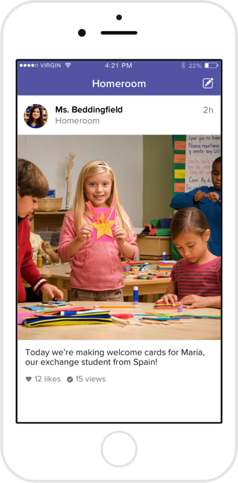
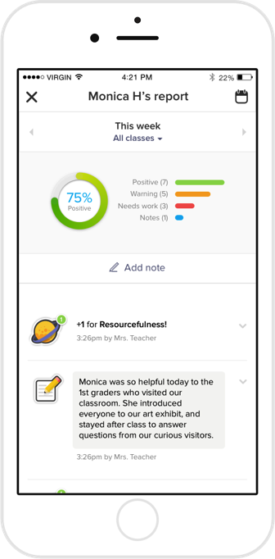
What do parents see?
You’ll see the Story of our classroom:
Photos and videos from class
Important updates and announcements
Private messaging between you and staff.

Slide 14

Classroom learning behaviour

Slide 15
Classroom learning behaviour
In class and around school we have lots of ways to recognise and celebrate positive behaviour. This includes:
Verbal positive praise
Pozzy notes
Weekly achievement certificate
Hot Chocolate with Mr Rogers
Where we see more persistent negative behaviours we give warnings followed by impositions (time to reflect during break times) and speaking to parents where necessary.

Slide 16
Our mission statement

Slide 17
Our mission statement

Slide 18
Any concerns
Any questions?
If you have any further questions or anything specific regarding your child please send a message via Dojo.
Any issues or concerns over the course of the year please do let us know.

