Slide 1
Welcome to Reception
Miss Roberts
Miss Chestnutt
Miss Kirsty

Slide 2
In this presentation we will cover:
EYFS Curriculum
EYFS Goals
Timetables
Read Write Inc
PE and Forest School
Child Initiated
Dojo
Classroom Learning Behaviour
Check List
Christian Values
School Values

Slide 3
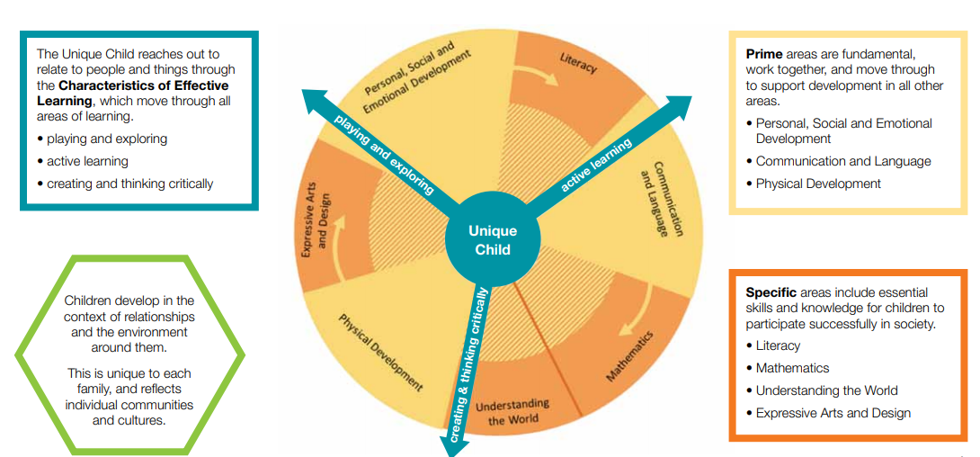
EYFS Curriculum – This is our curriculum. It’s broken into Prime and Specific.
The EYFS development matters framework has recently been updated. You can find the latest version here: https://www.gov.uk/government/publications/development-matters--2

Slide 4
EYFS Goals
Tracking – We have a monitoring system in reception. We observe the children during play to assess their understanding and development. We follow the different developmental stages, gathering observations to create a baseline. We then use this baseline to track their development.
We follow a “Good level of development” – This looks at Literacy (reading, writing), maths (number and shape), all CLL areas (communicating, language, literacy), all PSED and physical.

Slide 5
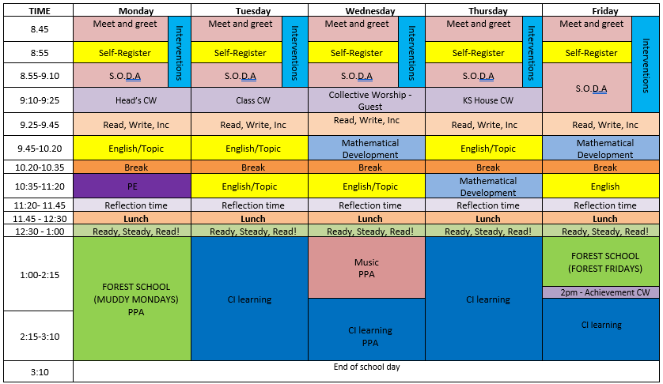
Forest School currently is not taking place due to the new building work behind the school but will hopefully continue again after half term. I will make sure parents have lots of notice before hand!

Slide 6
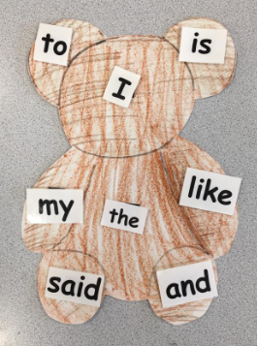
Read Write Inc - phonics
Every day (apart from Tuesday)
Read Write Inc is a structured programme using phonics
It starts your child reading and writing – mark making
We start introducing the sound, what it looks like, how we write it
We say “now that you’ve been shown, you can practise on your own”
At home learning – We encourage reading at home – this will continuing their learning. We will be sending home bear words that need to be taught. If you see any numbers and letters in your environment, point these out, can your child tell you what they are?

Slide 7
Topic Work
Every term a new Early Years topic or theme is chosen to help support children’s knowledge and understanding of the world.
These topics are chosen from the children's interests and therefore not set for each year. Pervious popular topics have been; Fairy Tales, Dinosaurs, Where we live, Superheroes, Autumn Leaves, Christmas, Harvest, Spring, Life Cycles – Growing Flowers.
Each topic covers a variety of the EYFS curriculum to include maths, English, understanding the world and expressive art and design.
For the first half of the term, the topic is always ‘The Wonderful Me’. This enables the children to introduce themselves to their new class and their new teachers and everyone can get to know each other!

Slide 8

Pe and Forest School
PE – Every Monday after break with Mr Sheridon. Children are to come to school in PE kit and will stay in their PE kit all day. After , children will come to school in their PE kits with uniform in their bags to change into.
Forest School (postponed until further notice)- This is usually on a Muddy Mondays and a Forest Friday – incorporating with maths, literacy, art, knowledge and understanding etc. Allowing children to explore the great outdoors! Children are to come to school in Forest School kit for the day. Wellies and waterproofs in bags.

Slide 9
Child Initiated Learning
We have child initiated learning every afternoon – there is also reading with Miss Roberts, Miss Kirtsy and Miss Chestnutt individually
This supports children in having ideas and being in control of their learning. It enables them to learn through first-hand experiences, allowing them to choose how to use the resources to do so.
It gives children ownership of their learning, providing many opportunities to celebrate everyone’s interests and achievements, promoting a culture of success in school.
Taking what we have learned in the classroom and develop further.
Child Initiated Learning helps children learn to share and cooperate without adult input or intervention. They have to work together to drive their activities, offering their ideas and opinions. Plus they can build strong friendship bonds on their common interests.

Slide 10
Dojo
Dojo is a reward system that is seen throughout our school, in every year group. A dojo can be given by any member of staff around the school and can be rewarded for lots of different reasons. For example, good behaviour, manners, sensible sitting and listening, trying their best with their work, team work, helping others etc.
Dojo is not a competition with the children but a recognition of being wonderful students.
We really want to encourage good behaviour in the classroom. We also love beautiful manners and lovely sharing
Communication from School through Dojo and text messages.
Friday – On a Friday we will be sending a message to show you what we’ve been learning in the week, what letters we have learned and maths so that you can reinforce at home!

Slide 11
Classroom learning behaviour
In class and around school we have lots of ways to recognise and celebrate positive behaviour. This includes:
Dojos – Dojo star of the day
Recognition board
Pozzy notes
Weekly achievement certificate (every Friday)
Hot Chocolate with Mr Rogers (every Friday)
Where we see more persistent negative behaviours we give warnings followed by impositions (time to reflect during break times) and speaking to parents where necessary.

Slide 12
Check List
Water bottles – We do have names cups in class but if you do want to bring in a water bottle, please make sure they’re labelled.
Suncream – On a sunny day please apply in the morning, we can reapply in the day. Please leave suncream in their bags.
Names in all clothes – please make sure all clothes (and shoes) are labelled.
ParentPay – To pay for the break time toast, please sign up to ParentPay
Always ensure that your details are up to date

Slide 13
Core Christian Values – the way we work.
Our vision and mission are underpinned by our core values, which reflect the qualities and attributes of the Christian ideal.
These are:
Love – we treat others as we would want to be treated, in the way of Jesus Christ.
Honesty – we are truthful, with a strong moral principle.
Courage – we embrace new and challenging experiences
Quality – we try our best in all that we do.
Community - we help each other to learn
These are the principles that drive our behaviour. We expect this from everyone in our community.

Slide 14
School Rules
Be Ready
Be Respectful
Be Safe
Our Core Christian Values
Honesty
Community
Love
Courage
Quality

Slide 15
If you ever have any worries or concerns, we have an open door policy. Please feel free to contact us via Class Dojo, catch us after school or call to make an appointment.
If you have any questions, please send me a message on dojo and I’ll reply as soon as I can.

